Slide 1

Quality Center 9.2 - User module

Slide 2
Agenda
Agenda
Testing approach for QC
Create and manage test requirements
Design and build test plans
Organize tests into test sets
Define and schedule test execution flows
Record and track test execution results
Log and manage defects
Generate reports and graphs – QC Demo

Slide 3
Why use QC
Central and Organized repository: of all tests and test documentation for scheduling and execution
Consistent and standard process for gathering and reporting test data, defect tracking
Create a repository to store all test results, metrics and collate
- manual test cases
- automated test scripts
Analyze the entire testing process with graphs and reports
Integrate with different automated HP tools

Slide 4
Test process workflow
Define Release
R
E
P
O
R
T
G
E
N
E
R
A
T
I
O
N
Requirement analysis
Test Plan preparation
Test execution
Defect management

Slide 5
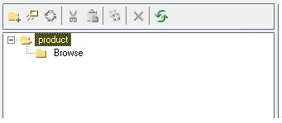
Release module
Define new releases in the Release module
Associate releases to requirements
Helps in traceability

Slide 6
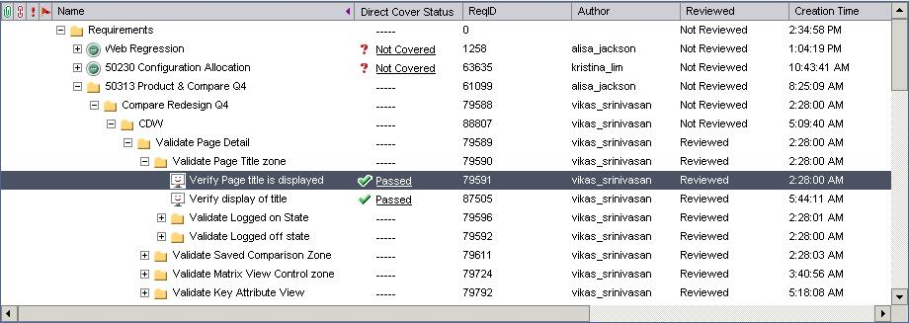
Requirements module
Requirements Tree view

Slide 7
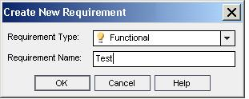
Requirements module
New requirement
Define requirement type
Requirement Name / Summary

Slide 8
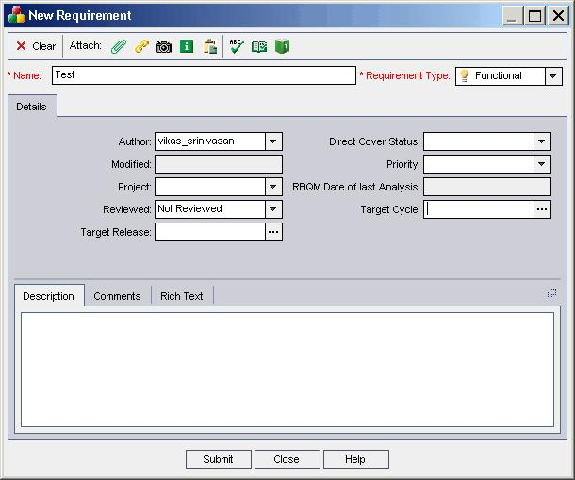
Requirements module
Requirement details

Slide 9
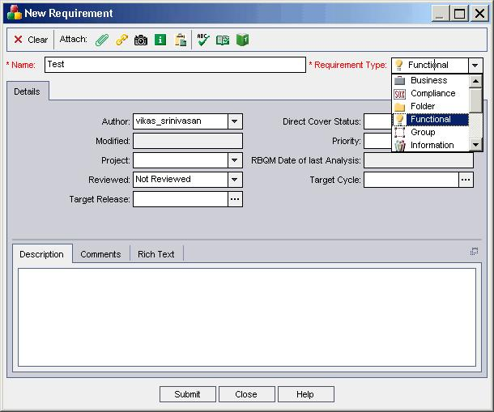
Requirements module
Requirement types
Business, Compliance, Folder, Functional, Group, Information. Performance, Testing, Undefined or User Interface

Slide 10
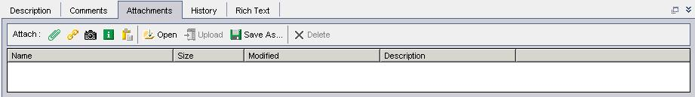
Requirements module
Attachment utility for QC requirements module
Attach a file
Define a URL
Snapshot tool

Slide 11
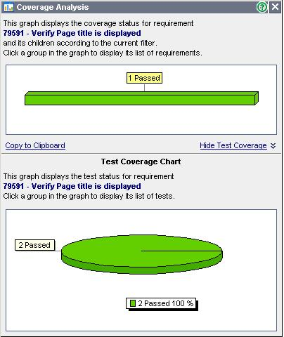
Requirements module
Direct Cover status for a requirement
Provides coverage analysis per requirement
Ensure traceability

Slide 12
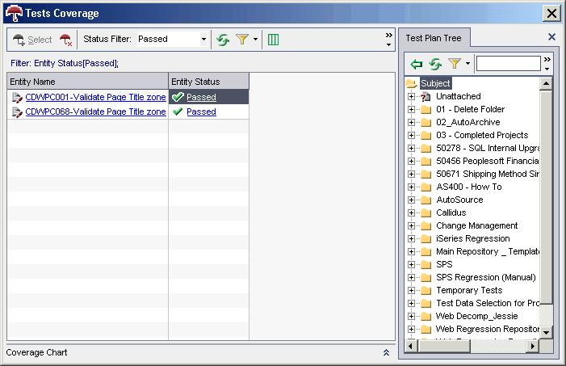
Requirements module
Direct Cover status for a requirement – Test Coverage

Slide 13
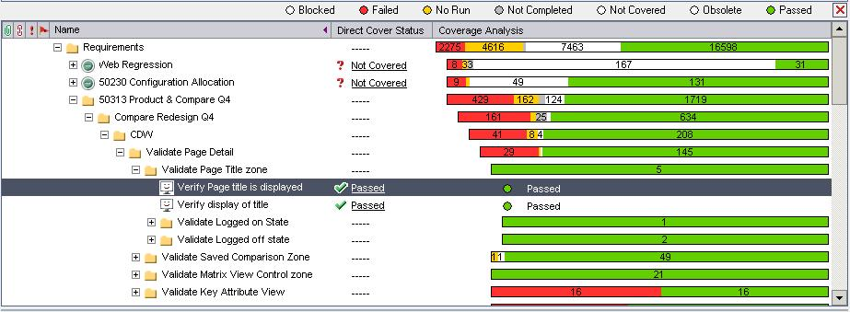
Requirements module
Requirements coverage view

Slide 14

Requirements module
Email requirement

Slide 15






Test plan module – Typical approach
Create folder structure
Create template tests for re-usability
Create test cases in respective folders
Call to test to copy design steps
Add design steps if required
Define requirement coverage

Slide 16
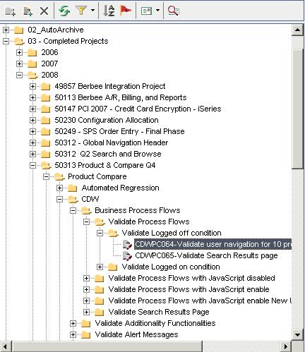
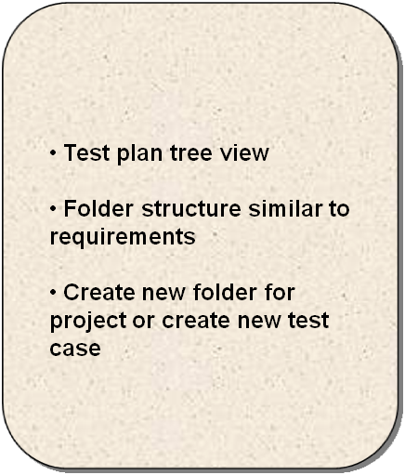
Test plan module

Slide 17
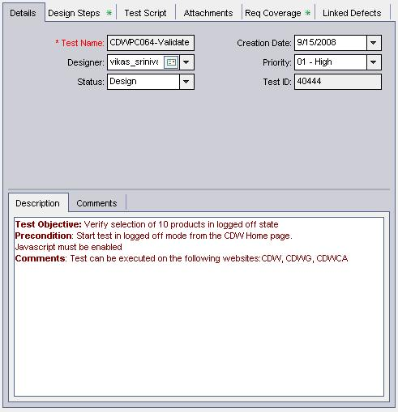

Test plan module
Requirement details
Test objective
Pre condition
Comments
Priority of test case needs to be defined

Slide 18
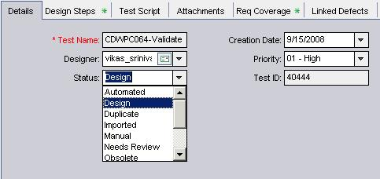
Test plan module
Test case status
Automated, Design, Duplicate, Imported, Manual, Needs Review, Obsolete, Ready, Repair and Repair manual

Slide 19
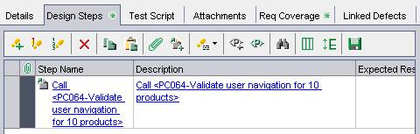
Test plan module
Design steps imported from template tests

Slide 20
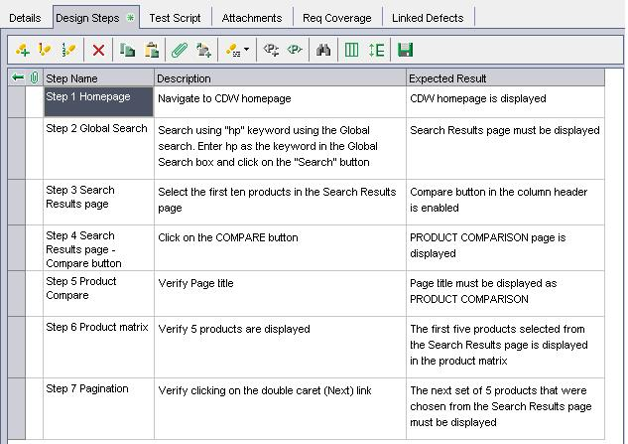
Test plan module
Design steps for template tests

Slide 21
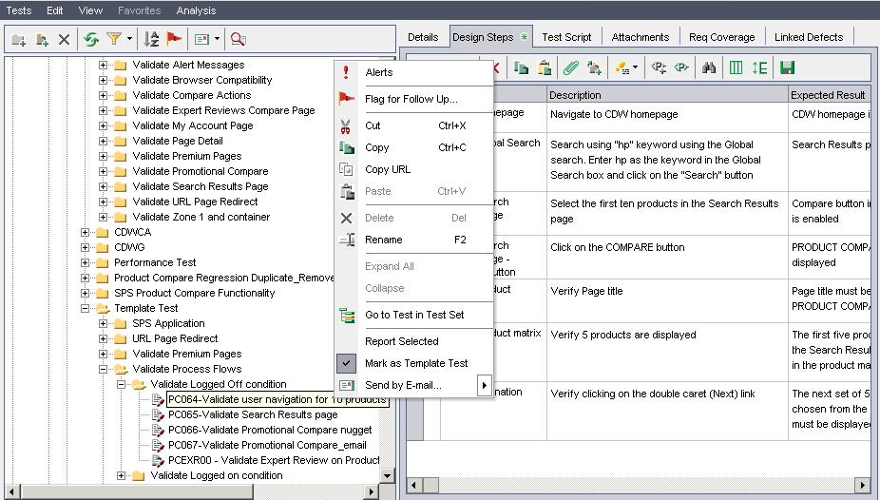
Test plan module
Design steps for template tests

Slide 22
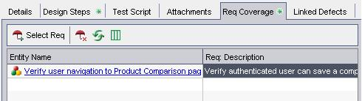
Test plan module
Requirement Coverage
Select requirements that are covered using the test case

Slide 23
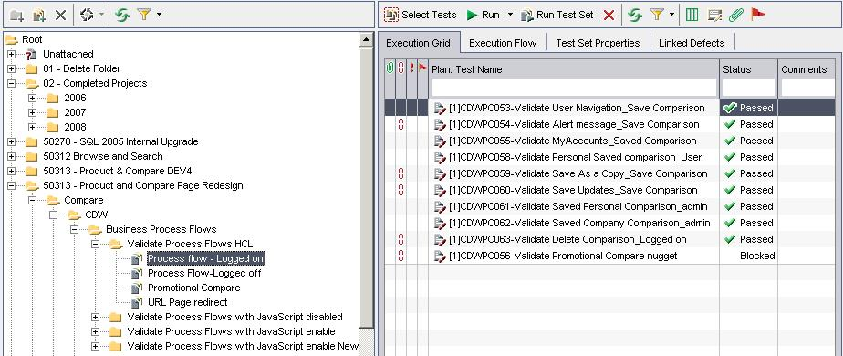
Test lab module
Test lab – Tree view

Slide 24
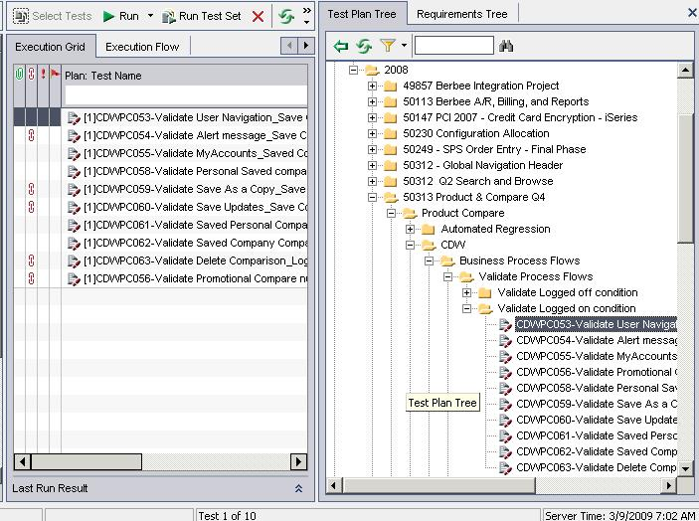
Test lab module
Select test cases to run in a test set

Slide 25
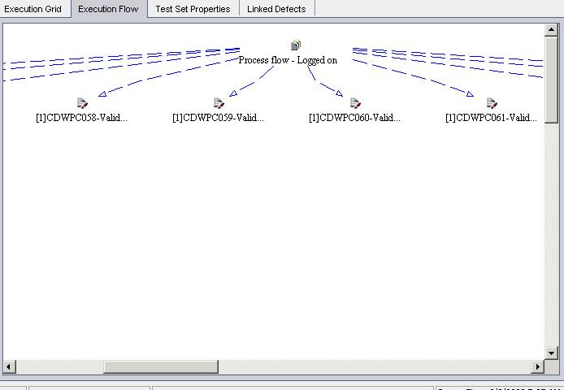
Test lab module
Execution flow

Slide 26
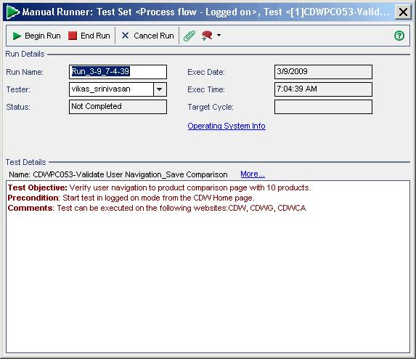
Test lab module
Test execution

Slide 27
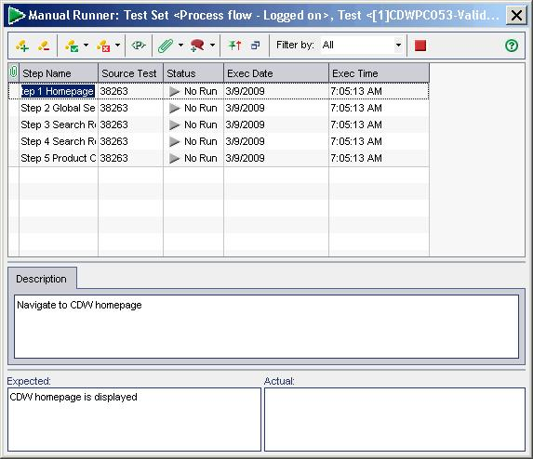
Test lab module
Execute each step as defined in the design steps

Slide 28
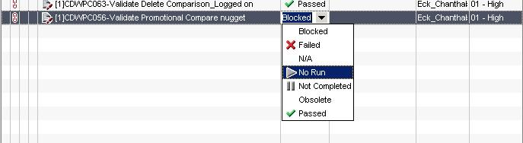
Test lab module
Test execution status

Slide 29
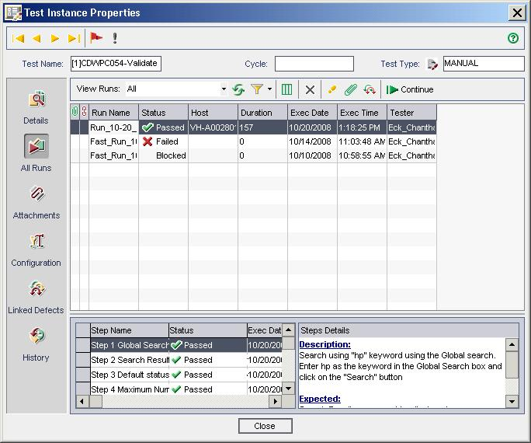
Test lab module
Test instance

Slide 30
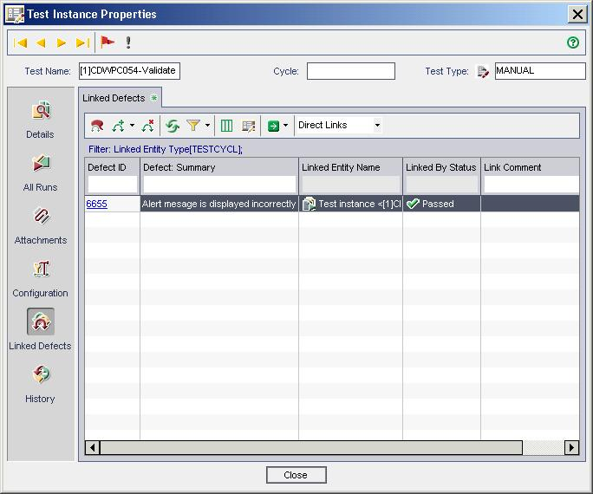
Test lab module
Test instance properties

Slide 31
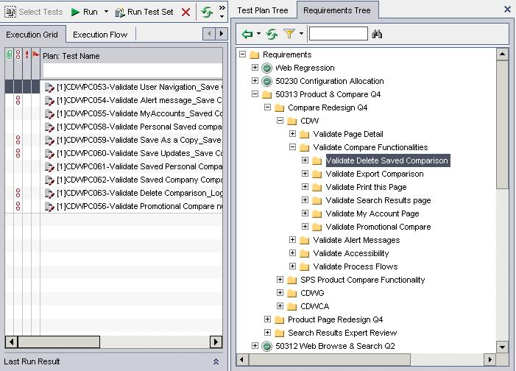
Test lab module
Select tests based on requirements

Slide 32
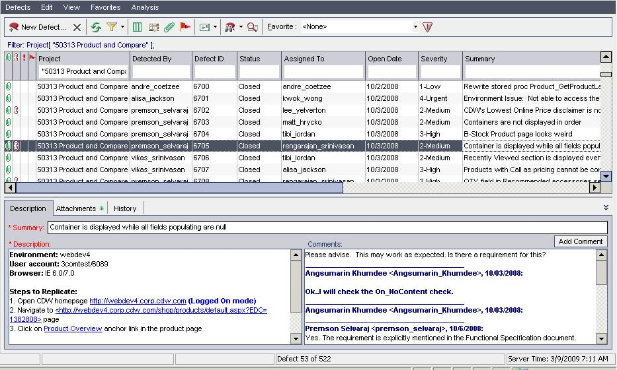
Defects module - Overview

Slide 33
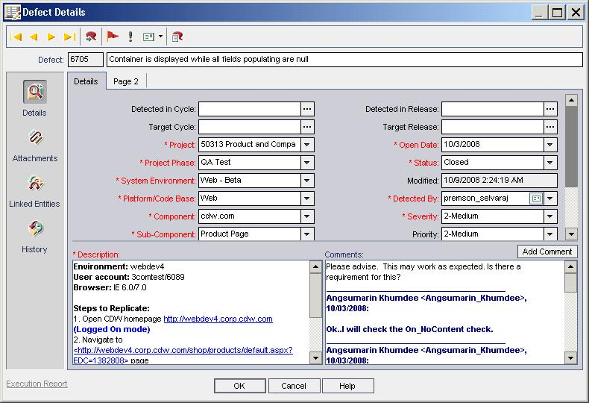
Defects module – Defect details

Slide 34
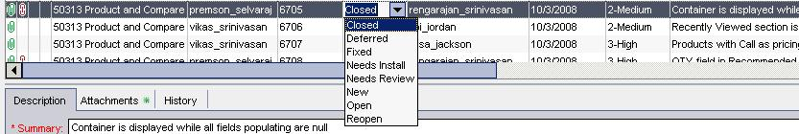
Defect module – Status of defects

Slide 35
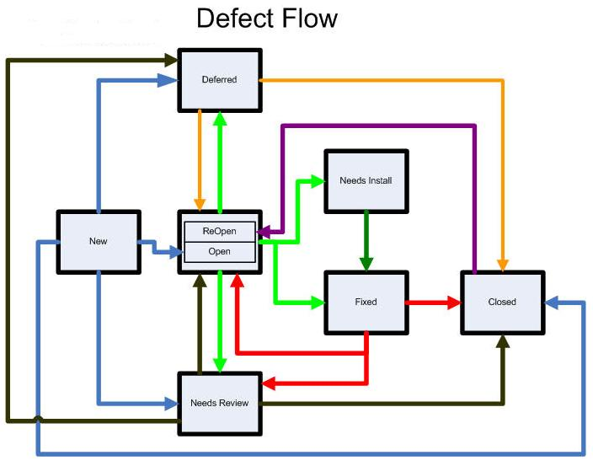
Defect lifecycle

Slide 36
Reports and Graphs
Three types of graphs:
  Summary
  Trend
  Progress
QC Demo

Slide 37


Slide 38


